Slide 1
🩺 Liver Disease an End-to-end ML Project
Presented by Mohd Nazimuddin

Slide 2
Table of contents
INTRODUCTION
DATA DESCRIPTION
DATA PREPROCESSING
EXPLORATORY DATA ANALYSIS
MODEL SELECTION & BUIDLING
MODEL EVALUATION & ANALYSIS
DEPLOYMENT
CONCLUSION

Slide 3
Objective
Develop a predictive model to classify liver disease status using laboratory test data.
Enhance medical diagnosis accuracy and support clinical decision-making.
Liver diseases are a major global health concern, often detected late.
Early diagnosis improves treatment outcomes and reduces healthcare costs.
Machine learning enables scalable, data‑driven diagnosis using routine lab tests.

Slide 4
Project Overview
Project goals: Building a classification model for liver diseases (No disease, suspect, hepatitis C, fibrosis, cirrhosis). Emphasize the importance of timely diagnosis and Streamlit deployment.
Business Value:
Support clinicians with decision‑making.
Enable cost‑effective screening using biochemical data.
Reduce reliance on invasive or expensive diagnostic methods.
Technical Scope:
Dataset: 615 patient records, 13 features.
Approach: Preprocessing → EDA → Model Building → Evaluation → Deployment.
Deployment: Interactive Streamlit app for real‑time predictions.

Slide 5
Data Description
The dataset used for this project was sourced from clinical records of patient laboratory measurements conducted at a leading healthcare facility. It contains detailed information on patients’ biochemical markers and demographics, with both numerical and categorical features, aimed at classifying liver disease status.
Dataset Size: 615 rows × 13 columns.
Features:
Demographics: Age, Sex.
Biochemical markers: Albumin, Bilirubin, Cholesterol, Protein.
Enzymes: ALT, AST, Alkaline Phosphatase, GGT, Cholinesterase.
Kidney function: Creatinine.
Target Variable : The “Category” column
Visuals: Table of features with normal ranges.
Duplicates: 0 duplicate records

Slide 6
Data Preprocessing
Identified and handled missing values in the dataset using boxplots and the IQR method to detect outliers and anomalies.
Numerical features (e.g., bilirubin, albumin, ALT, AST, age) and categorical features (e.g., gender, disease classification) were identified for preprocessing.
Numerical features were scaled using Standard Scaling and Min-Max Scaling to normalize their ranges and ensure compatibility with machine learning algorithms.
Categorical features were converted into numerical formats using One-Hot Encoding (for features with few unique categories, such as gender) and Label Encoding (for features with many unique categories, such as disease classifications).
The dataset was transformed into a final encoded DataFrame, ready for model training and evaluation

Slide 7
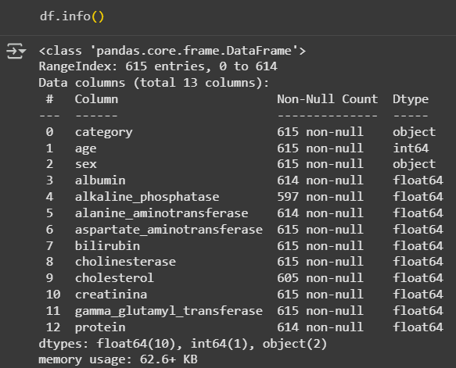
Exploratory Data Analysis (EDA)
SUMMARY
CORRELATION
VISUALIZATION
Calculated statistical summary to understand the central tendency and distribution of the variables
Created visualizations to understand distributions, relationships, and patterns in the data
Identified relationships between variables, including correlations and potential interactions

Slide 8
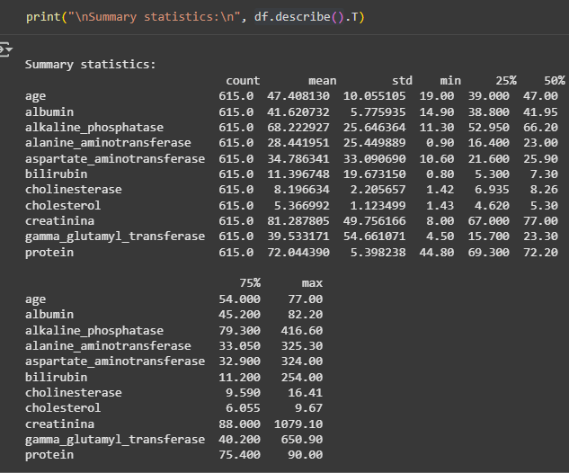
Distribution Analysis: ALT, AST, and Bilirubin show skewness.
Correlation Heatmap: ALT & AST strongly correlated.
Class Balance: Imbalance observed (more “No disease” cases).
Insights:
High ALT/AST → liver damage.
Low Albumin/Cholinesterase → cirrhosis. Visuals:
Histogram of ALT.
Heatmap of correlations.
Bar chart of class distribution.

Slide 9
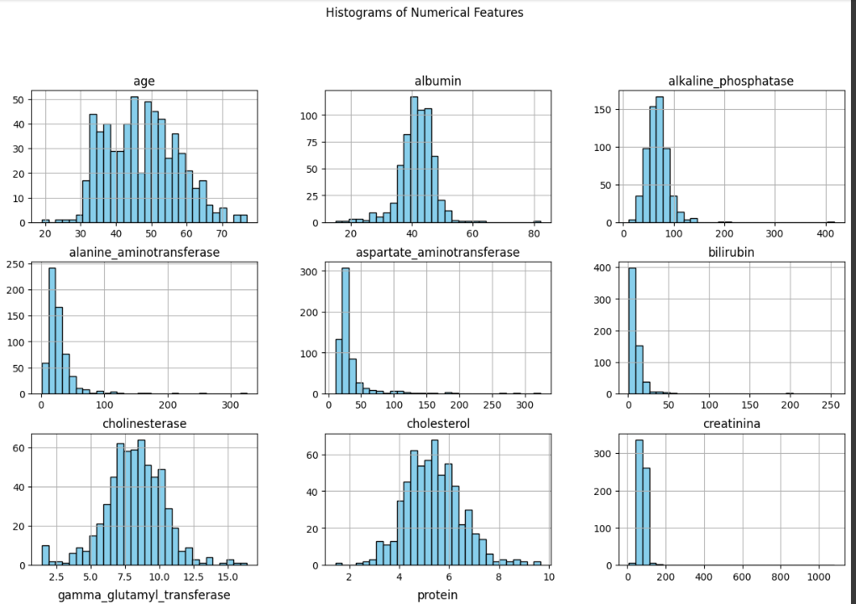
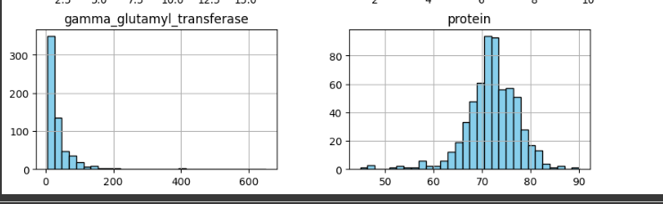

Slide 10
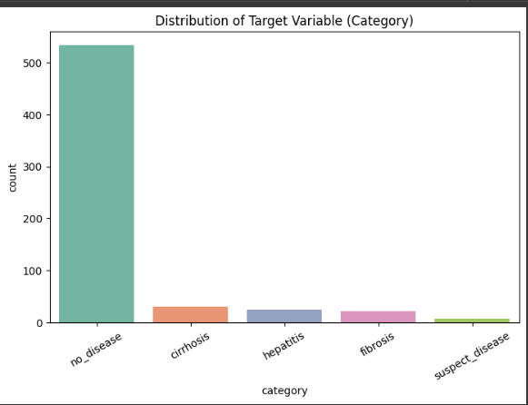
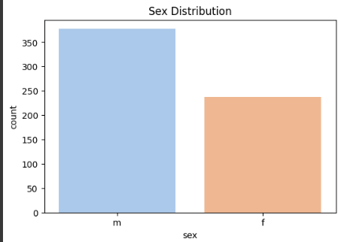
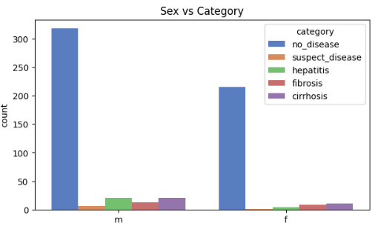

Slide 11
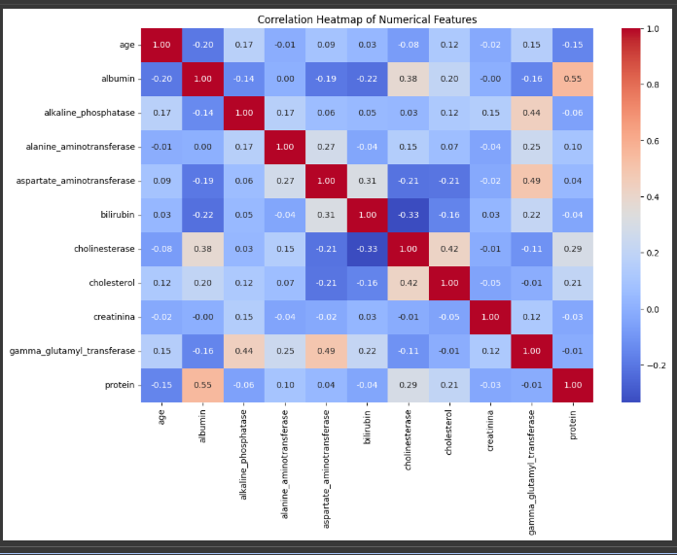
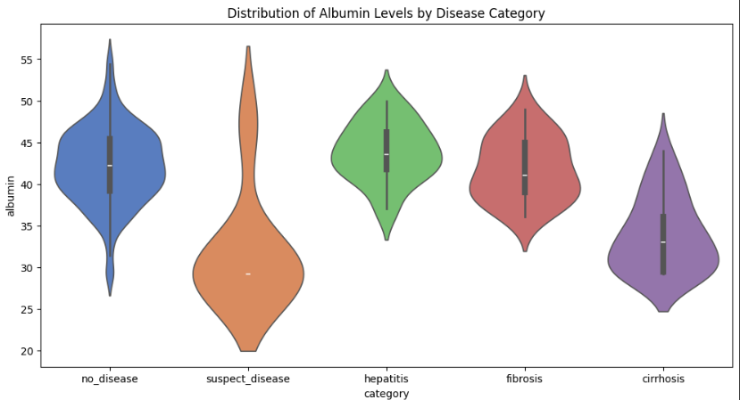

Slide 12
Histograms of Numerical Features
Shows the distribution of various biochemical and demographic features such as age, albumin, bilirubin, and others.
Many features (e.g., alkaline phosphatase and bilirubin) are right-skewed, while some like cholinesterase are normally distributed.
Distribution of Target and Gender Variables
No Disease is the predominant category, with markedly fewer cases of fibrosis, hepatitis, and cirrhosis.
Males dominate the dataset with nearly twice as many observations compared to females.
Sex vs Category
Most males and females belong to the No Disease group, with balanced gender representation for smaller disease categories.
Minor disease types, like cirrhosis and fibrosis, show sparse representation across both genders.
Correlation Heatmap
Albumin and protein have the strongest positive correlation (~0.55) among features.
Weak correlations dominate, with some negative ones like age vs albumin.
Albumin Levels by Disease
No Disease group exhibits the highest albumin levels, while hepatitis and cirrhosis show noticeably lower levels.
Albumin distribution varies significantly across disease categories, making it a critical diagnostic biomarker.

Slide 13
Model Selection & Building
The disease classification column represents the liver disease status of patients, categorized into classes such as no disease, suspect disease, hepatitis, fibrosis, and cirrhosis.
Since the target variable (disease classification) is categorical, the task is a Classification Problem.
Here are some key steps in the model-building process:
Data Split: Split the dataset into training and testing sets using 80:20 ratio to ensure unbiased evaluation.
Model Selection: Choose suitable classification models based on the problem and data type, such as Logistic Regression, Random Forest, Gradient Boosting, or SVM.
Model Training: Train the selected model using the training data to learn patterns in the biochemical markers and demographics.
Feature Selection: Recursive Feature Elimination (RFE), Feature Importance.
Visuals: ML pipeline diagram.

Slide 14
Model Evaluation & Analysis
Metrics used: Accuracy, Precision, Recall, F1‑score.
Random Forest & KNN performed best.
Error Analysis: Misclassification between fibrosis & cirrhosis. Visuals:
Confusion matrix heatmap.
Table of metrics.
ROC curve (One‑vs‑Rest).

Slide 15
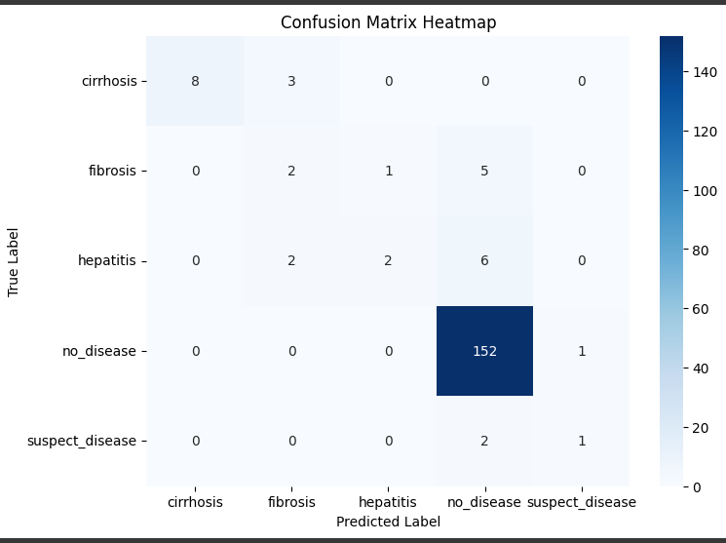
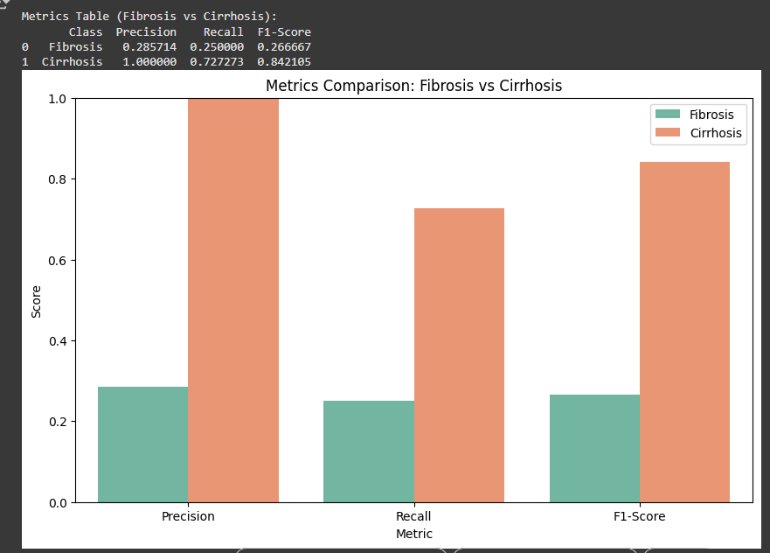

Slide 16
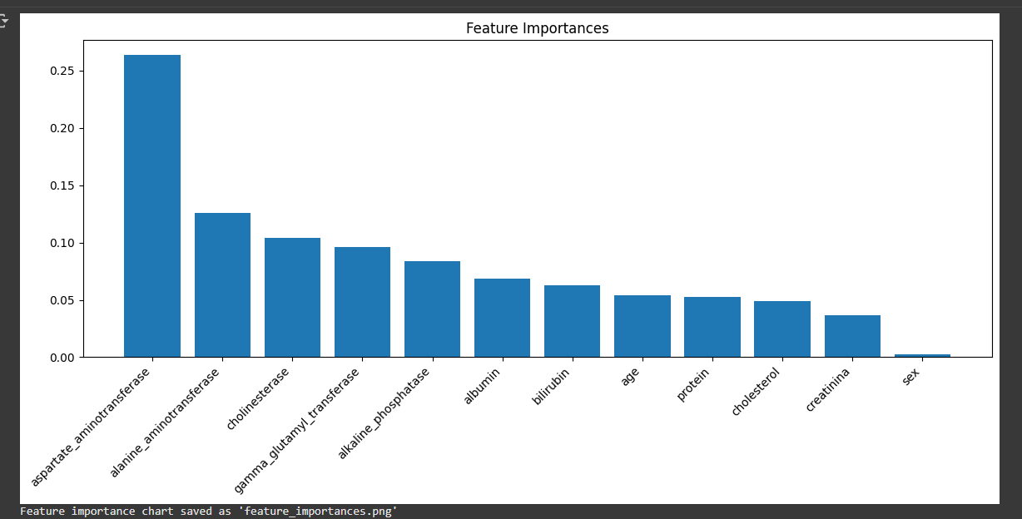
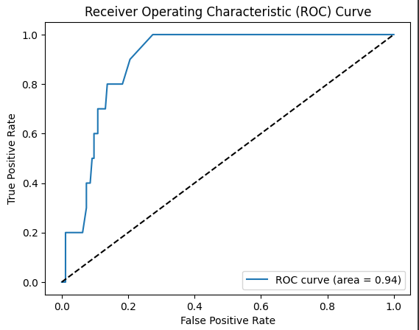

Slide 17
Random Forest Classification (Tuned) emerged as the best model with the highest ROC-AUC score, demonstrating superior performance in predicting liver disease status.
Tree-based models (Random Forest Classification, Decision Tree Classification, Gradient Boosting) performed significantly better than linear models (e.g., Logistic Regression) due to their ability to capture non-linear relationships in the data.
Hyperparameter tuning further improved performance for most models, ensuring optimal configurations for accuracy and generalization.
Logistic Regression Classification showed moderate results, while Support Vector Machine (SVM) performed poorly due to its inability to handle the dataset’s complexity and feature interactions.

Slide 18
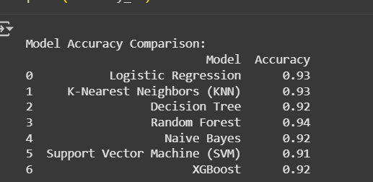
Confusion Matrix Analysis: The confusion matrix for the Random Forest Classification model revealed:
High True Positives (TP): Correctly predicted cases of hepatitis, fibrosis, and cirrhosis.
Low False Positives (FP): Minimal misclassifications of no disease as suspect disease.
High True Negatives (TN): Correctly identified patients with no liver disease.
Low False Negatives (FN): Few cases of misclassifying advanced liver disease as early-stage or no disease.
Overall, Random Forest Classification proved to be the most suitable model for predicting liver disease status in this case.”

Slide 19
Deployment
Save the trained model
Save the trained model and any required preprocessing objects (like scalers or encoders) to files.Export the best performing model using joblib.
Run and share the application
Verify that the deployed application is accessible and that predictions are working correctly.Run the streamlit app locally
05
01
04
Build Web API
Write a Python script that loads the model and preprocessing objects, and uses a web framework (like Streamlit, Flask, or FastAPI) to create an interface for predictions.
Implement Predictions and Display Results
User inputs are collected, transformed, and passed to the model.The model outputs the predicted selling price.
02
03
Load the model in the App
Integrated the saved model into the Streamlit application.Ensured preprocessing steps were aligned with training.

Slide 20
Save the Trained Model: The best-performing model (Random forest in this case) was saved to a file using joblib. This allows us to load the model later without retraining it.
Create a Web Application Interface: A simple web application was created using Streamlit (app.py) to serve as the interface for interacting with the model. This application takes user inputs for car features.
Load the Trained Model in the Application: The saved model file was loaded into the Streamlit application.
Implement Prediction Logic: The application was set up to take the user's input, preprocess it if necessary (though in this case, the model was trained on already processed data), and use the loaded model to predict the liver disease category (e.g., fibrosis, cirrhosis, hepatitis).
Display the Prediction: The predicted liver disease category (e.g., fibrosis, cirrhosis, hepatitis) was displayed to the user in the Streamlit application.
Run the Application: The Streamlit application was run, making it accessible. In this notebook, we used localtunnel to create a public URL for the local Streamlit application.

Slide 21
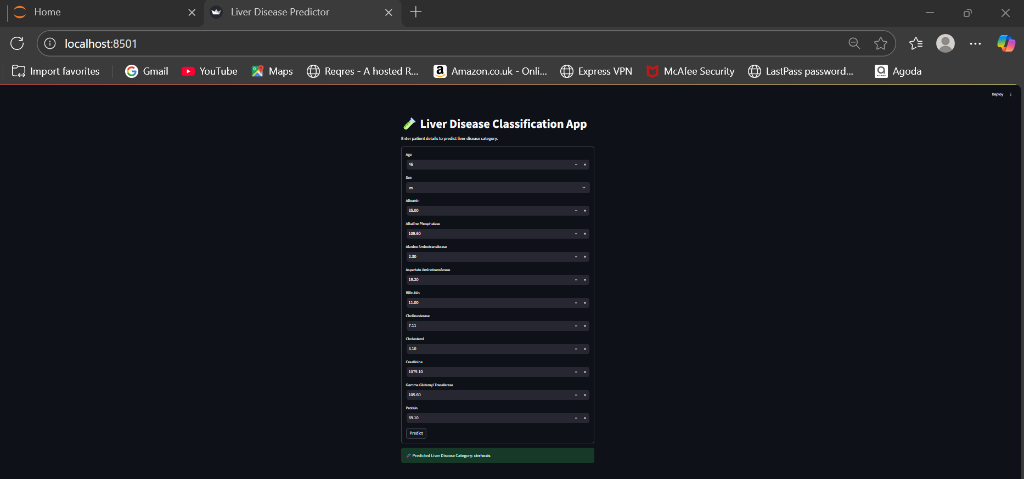
User interface

Slide 22
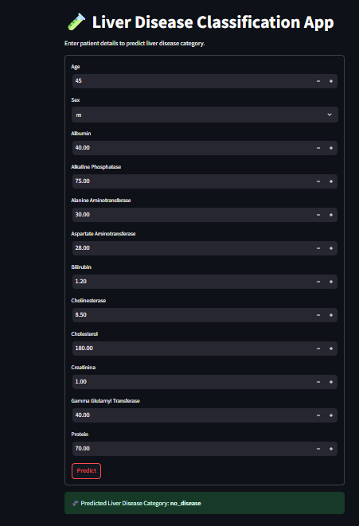
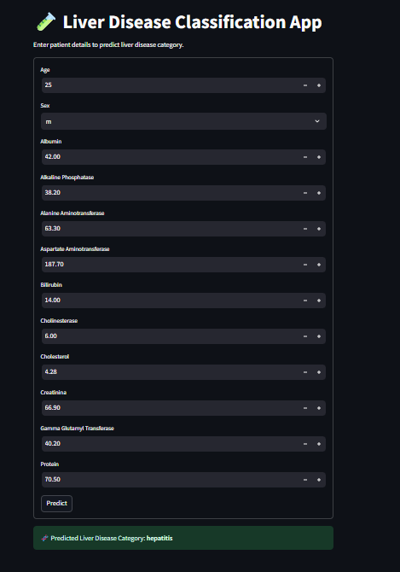
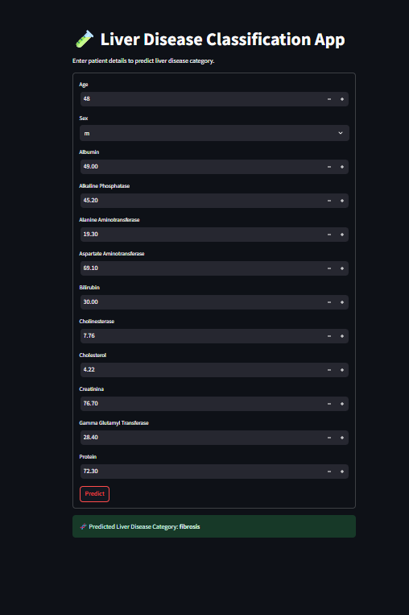

Slide 23
Conclusion
We successfully developed a machine learning model to predict liver disease categories with high accuracy.
Among the tested models, Random forest delivered the best performance, achieving strong classification metrics such as precision, recall, and ROC-AUC scores.
Key factors influencing liver disease prediction included biochemical markers like albumin, bilirubin, and patient demographics such as age and sex.
The final model was deployed in a Streamlit application, enabling healthcare professionals to input patient data and receive real-time predictions for disease classification.
This project demonstrates how data-driven approaches can improve decision-making in healthcare by providing accurate and reliable predictions for liver disease stages, aiding in early diagnosis and treatment planning.

Slide 24
Thank you
Questions and discussions welcome

